Slide 1
LAB 4 SOLUTION

Slide 2
Top Construction (overview)
Edge detector
LED controller
Pmod_JSTK2
Edge detector
Filters
Pmod_I2S2
Moving average
Mute
Volume
Balance

Slide 3
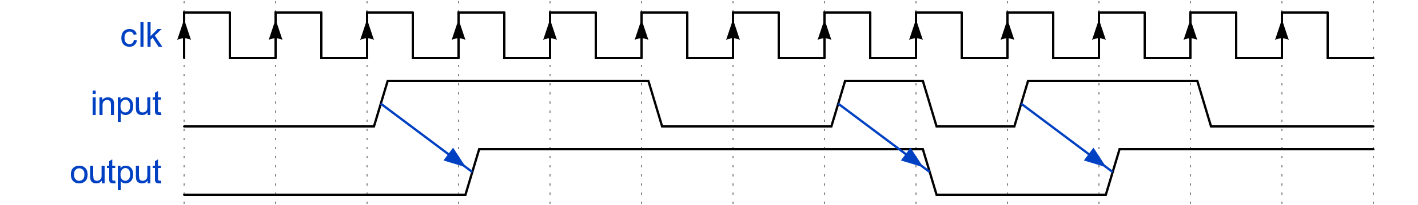
Edge detector
This module “detects” a 0→1 or 1→0 transition (selectable by generic). At each transition, it toggles the output.
Notes:
{signal: [
{name: 'clk', wave: 'P............'},
{name: 'input', wave: '0.1..0.101.0.', node: '..A....B.C...'},
{name: 'output', wave: '0..1....0.1..', node: '...D....E.F..'}
],
edge: [ 'A->D', 'B->E', 'C->F' ]
}

Slide 4
Edge detector implementation
This can be done by sampling the input at each clock cycle and comparing the current value with the old one, sampled at the last clock cycle.
input_signal_old <= input_signal;
if input_signal_old = '0' and input_signal = ‘1’ then
output_signal_int <= not output_signal_int;
end if;

Slide 5
LED controller
The LED controller has just to select the correct LED color based on two signals: mute_enabled (whether the audio is muted or not) and filter_enable (whether the moving average filter is enabled or not).
 | filter_enable = 0 | filter_enable = 1
mute_enable = 0 | GREEN | BLUE
mute_enable = 1 | RED | RED

Slide 6
LED controller implementation
This can be done with simple combinatorial logic, both in dataflow
or in behavioral
led_r <= x”ff” when mute_enable = '1' else x”00” ;
led_g <= x”ff” when mute_enable = '0' and filter_enable = '0' else x”00” ;
led_b <= x”ff” when mute_enable = '0' and filter_enable = '1' else x”00” ;
…
if mute_enable = '1' then
led_r <= (others => '1');
elsif filter_enable = '1' then
led_b <= (others => '1');
else
led_g <= (others => '1');
end if;

Slide 7
Filters
On the audio path, transferred through an AXI4-Stream interface, we have four “filters”:
Mute controller
Moving average filter
Balance controller
Volume controller
They are connected in daisy chain and their order is not particularly important.

Slide 8
Mute controller
To mute the audio stream it is sufficient to remove its data component (by zeroing it or by keeping it constant to the last value) for both audio channels.
It is important to remember that the data samples must always be transferred at the 44.1 kHz rate, it is not possible to decimate them (for example, by keeping tvalid low).

Slide 9
Mute controller implementation
To do so, one solution is to introduce a simple combinatorial circuit which zeros the data channel when mute_enable is high.
Control signals pass unmodified
m_axis_tvalid <= s_axis_tvalid;
m_axis_tlast <= s_axis_tlast;
s_axis_tready <= m_axis_tready;
m_axis_tdata <= s_axis_tdata when mute_enable = '0' else (others => '0');
tdata is zeroed when mute_enable is high

Slide 10
Moving average filter
The two audio channels are independent, so they should be filtered independently.
The easiest way to do so is to design a single-channel moving average filter, instantiate it twice and describe the logic to route the data samples to the correct filter.
Additionally, data is transferred unmodified if filter_enable is low.

Slide 11
Moving average overview
Dual moving average filter
Moving average filter
LEFT
Channel
selector
Moving average filter
RIGHT
Output selector
1 clock cycle delay
(«pass-all» filter)

Slide 12
Moving average filter notes
Note that the filters always process the input data, regardless of the value of filter_enable.
In this way, at every moment, we have both the filtered and unfiltered streams and we can freely choose one or another based on the value of filter_enable, without having to wait for the shift registers of the moving average filters to fill up.

Slide 13
Balance controller
The scale of the balance requires a multiplication by 2**n, which translates into bit shifts.
The balance controller is split in two parts:
Compute the number of positions to shift the data, based on the value of the joystick axis.
Shift the correct channel by the required amount

Slide 14
Balance controller implementation
Step 1.
Move the 0 to 1023 scale to a -512 to 511 one
Center the steps
bal_s_f := signed(balance) - 2**(balance'length - 1) + 2**(BAL_STEP_SIZE - 1);
bal_s <= bal_s_f(balance'high downto BAL_STEP_SIZE)
Ignore the last BAL_STEP_SIZE bits (to have steps of 64)

Slide 15
Balance controller implementation
Step 2 (part 1).
Shift right by the correct number of positions
If we have to attenuate the left channel AND we are holding a left sample
if balance_shifted > 0 and s_axis_tlast = '0' then
m_axis_tdata <= std_logic_vector(shift_right(signed(s_axis_tdata), to_integer(balance_shifted)));
elsif balance_shifted < 0 and s_axis_tlast = '1' then
m_axis_tdata <= std_logic_vector(shift_right(signed(s_axis_tdata), to_integer(-balance_shifted)));
…
If we have to attenuate the right channel AND we are holding a right sample
Shift right by the correct number of positions (equal to -balance_shifted)

Slide 16
Balance controller implementation
Step 2 (part 2).
If the previous conditions are not satisfied (we have to attenuate the left/right channel, but we are holding a right/left sample)
…
else
m_axis_tdata <= s_axis_tdata;
end if;
Do not modify the data

Slide 17
Volume controller
The volume controller is mostly identical to the balance one, with just two differences:
left/right channels are amplified/attenuated by the same value
we can also amplify, so we have to make sure that the signal saturates, and not wraps around.

Slide 18
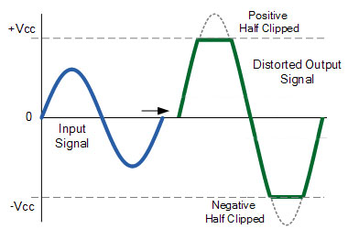
Volume controller: clipping
When amplifying the signal, we should check whether the resulting value fits in the 24-bit signed integer; if not, we should saturate it to the maximum/minimum value.

Slide 19
Volume controller implementation
Part 1
If we have to amplify, data might overflow: use a larger variable to store the data.
scaled_data := resize(signed(s_axis_tdata), scaled_data'length);
if volume_shifted >= 0 then
scaled_data := shift_left(scaled_data, to_integer(volume_shifted));
…
If we have to amplify
Shift left by the required amount (thanks to the temporary variable, this will not overflow)

Slide 20
Volume controller implementation
Part 2
If the amplified value is over the maximum value
force it to the maximum value
…
if scaled_data > 2**s_axis_tdata'high - 1 then
scaled_data := to_signed(2**s_axis_tdata'high - 1, scaled_data'length);
elsif scaled_data < -2**s_axis_tdata'high then
scaled_data := to_signed(-2**s_axis_tdata'high, scaled_data'length);
end if;
…
If the amplified value is below the minimum value
force it to the minimum value
If the amplified value falls between the limits, just keep it

Slide 21
Volume controller implementation
Part 3
Attenuate it, like with the balance controller (but without checking the channel)
If instead we have to attenuate
…
else
scaled_data := shift_right(scaled_data, to_integer(-volume_shifted));
end if;
m_axis_tdata <= std_logic_vector(scaled_data(m_axis_tdata'range));
At the end, take just the 24 Least Significant bits

